Slide 1
FunStop
Adding Some Fun to the Road
Annie Paul
April James
Ifrit Maruf
Joseph Ray
Kishan Brahmbhatt
Lan Nguyen
Wasif Siddiqui

Slide 2


We felt like road trips can be too monotonous and boring
[1].
[2].

Slide 3
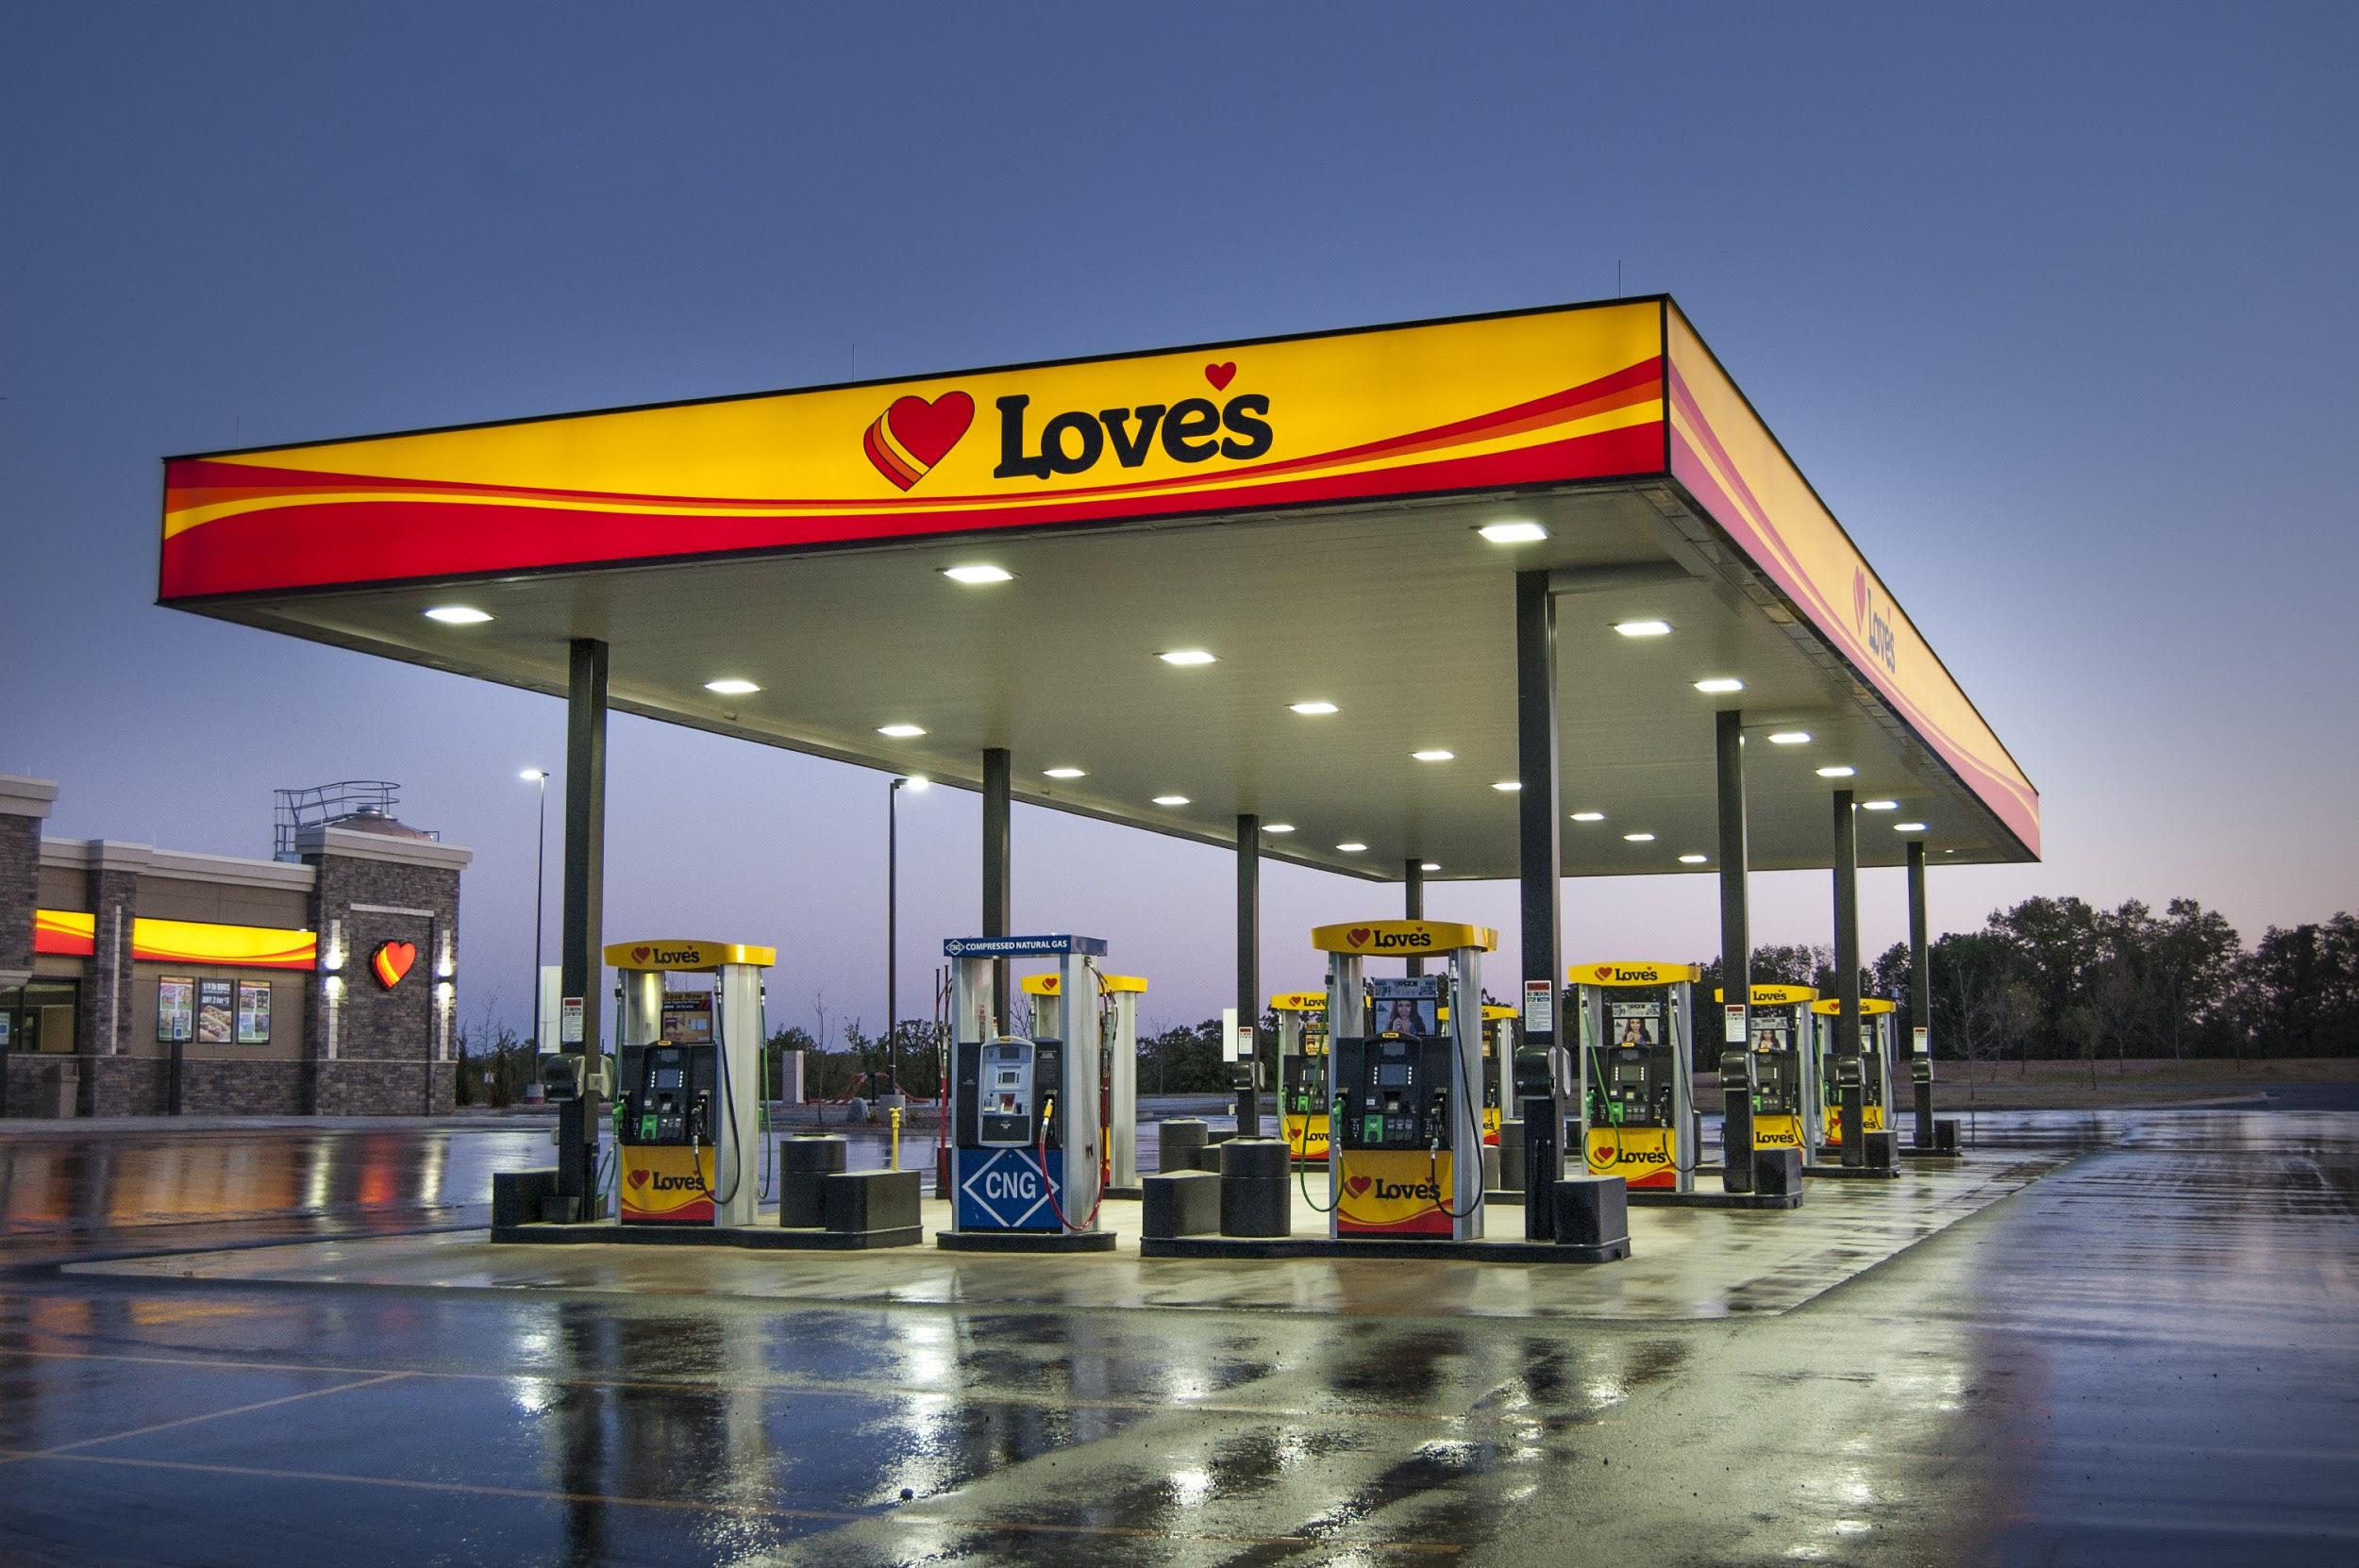
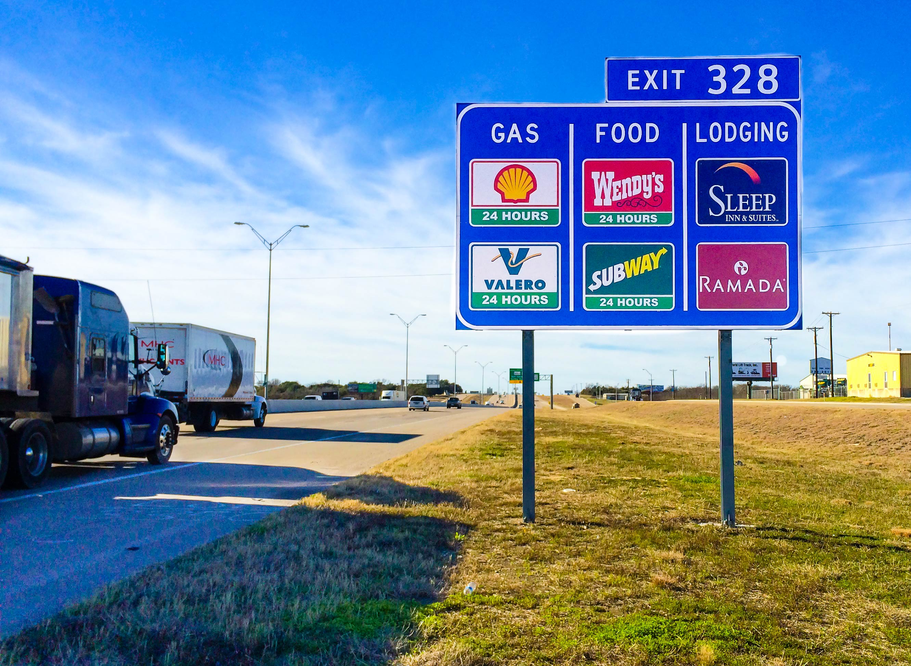
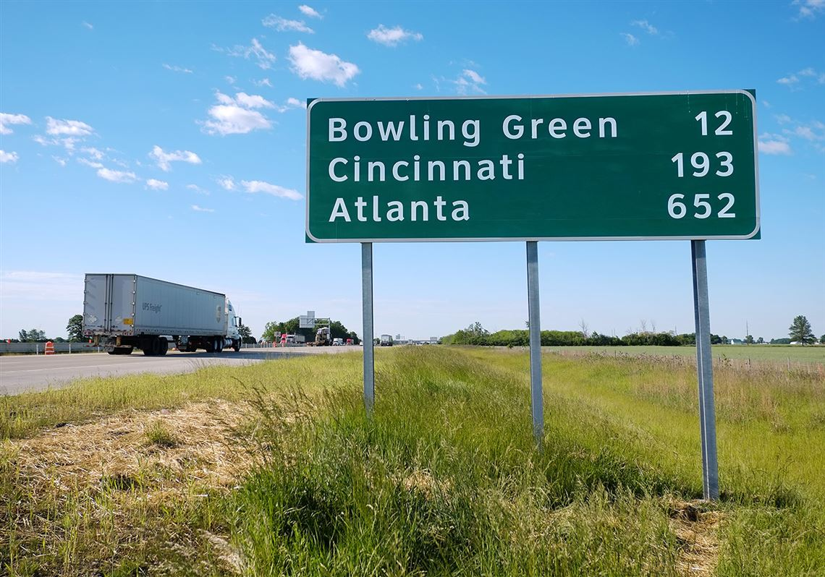
Only stopping for gas and the bathroom as well as the question of “Are we there yet?” are things we are trying to combat with FunStop
[3].
[4].
[5].

Slide 4


The goal of our phone application is to create a service with which users can find enjoyable stops along their routes on a road trip
[6].
[7].

Slide 5
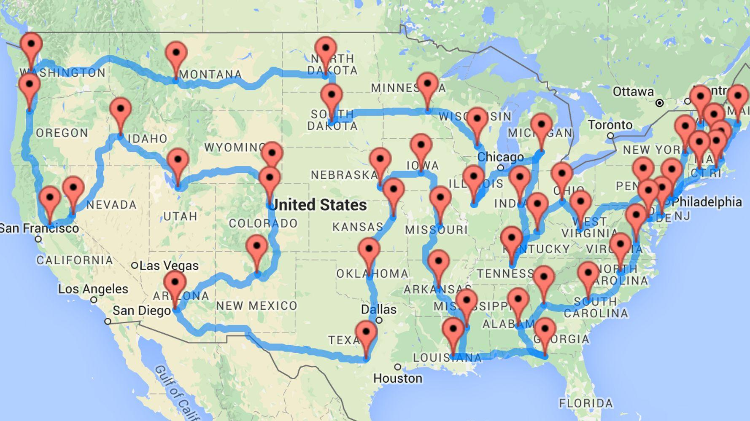
Users can create their own routes with custom stops along the way
[8].
[9].

Slide 6

Users can also search for publicly created routes made by other users
[10].

Slide 7
Cost Estimation
Cost of hardware products (such as servers, etc.):
We will be hosting our data on one of google’s server’s in their secure data center, this will cost $234.79/month
To keep our data for a year would cost about $2800.00
Cost of software products (such as licensed software, etc.):
Xcode is free and the best option for developing iOS applications
Cost of joining Apple’s developer program and adding an app to the app store is $99.00
Cost of personnel
Team of 7 programmers at $50/hour

Slide 8
Cost Estimation Cont’d
We are estimating the cost using Function Point Method
Number of Function Points: 125
Team Productivity: (25 Function Points)/(person-week)
5 person-weeks needed to complete the project.
5 / 7 = .71 → About one week needed to develop the app.
Add 1 week due to uncertainty, estimated 2 weeks needed
Based on app development data, a development team is paid $50/hour.
Team size: 7
Hours per person: 8 * 10 = 80
Total hours: 80 * 7 = 560
Total cost: 560 * 50 = $28,000.00 + $100.00 + 2800.00 = 30,900.00
Developing an iOS app with moderate functionality can cost up to $100,000. Ours is about $30,000 with very basic functionality and a short development time and small team.

Slide 9

Project Scheduling
According to Function Point: about 1 week
Productivity: 25 points per person-week
Team size: 7 people
Allocate 1 extra week for unexpected difficulties
Start date: January 4th
End date: January 18th
No work on weekends
~8 hours of work per day
Notes:
Annie

Slide 10

Functional Requirements
Allow users to create accounts/login
Allow users to create routes
Allow users to search routes
Allow users to save routes
Allow users to review routes
[11].

Slide 11
Non-functional Requirements (NFR)

Slide 12
NFR: Product Requirements
The system must manage memory usage to allow for background usage on roadtrips
The system must create downloadable routes to minimize data usage when away from cellular signal
The system must preserve state incase of app closure or crash

Slide 13
NFR: Organizational Requirements
The system must be compatible with iPhone 8 and newer
Updates must be developed in and pushed through Xcode
External software (password storage and verification, etc.) will be developed in Java
Application software will be developed in Swift using the Xcode IDE

Slide 14
NFR: External Requirements
The system must receive permission to obtain location data
The system shall not maintain personal location data
The system shall not disclose personal information about users to the operators of the system or third-parties

Slide 15
Diagrams
These below designs are the ones we are covering in our presentation
Use Case diagram
Sequence diagram for a selected representative operation of the project
Class diagram

Slide 16
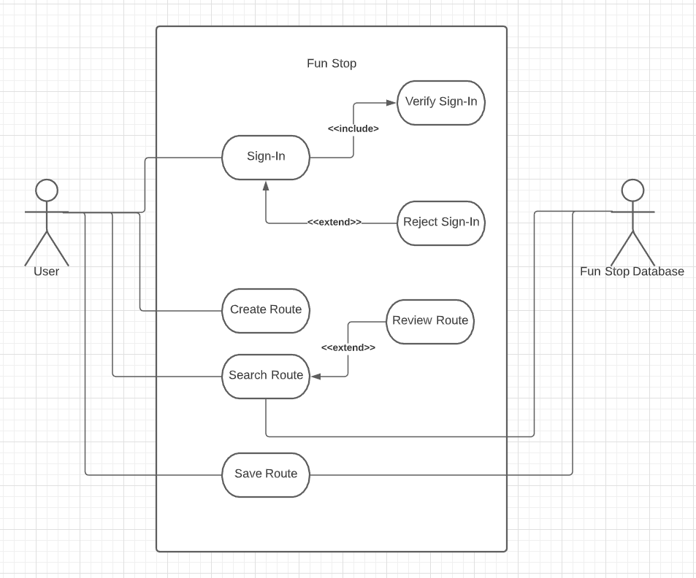
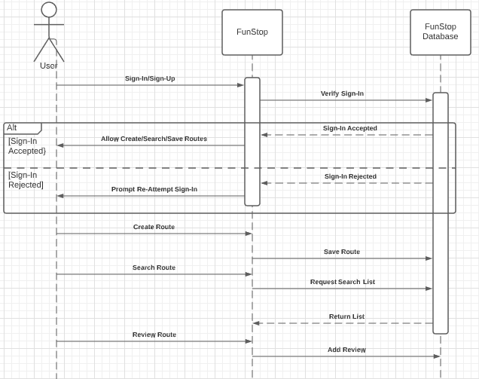
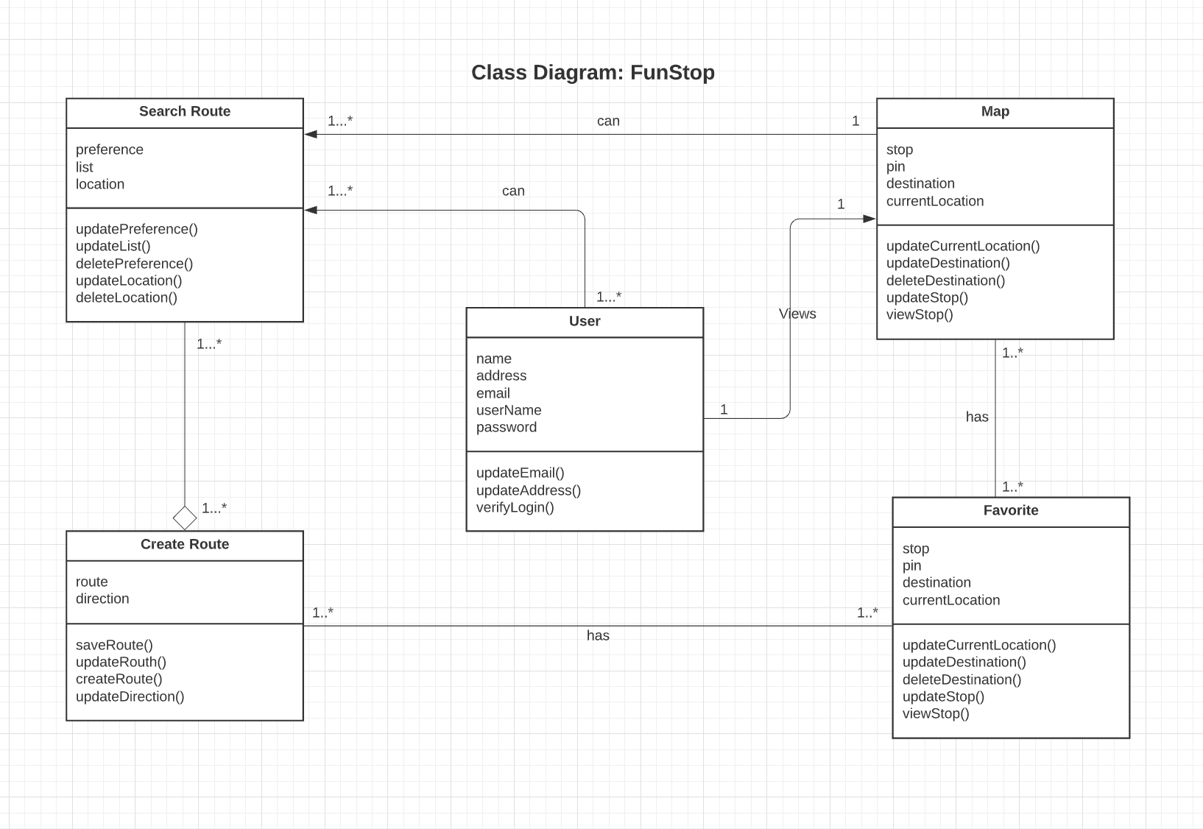
Use Case Diagram
Sequence Diagram
Class Diagram

Slide 17

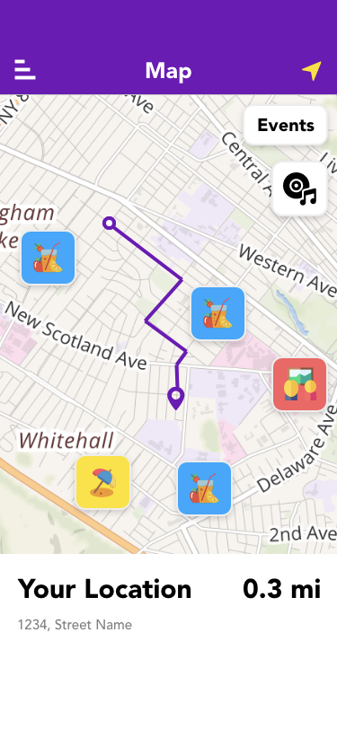
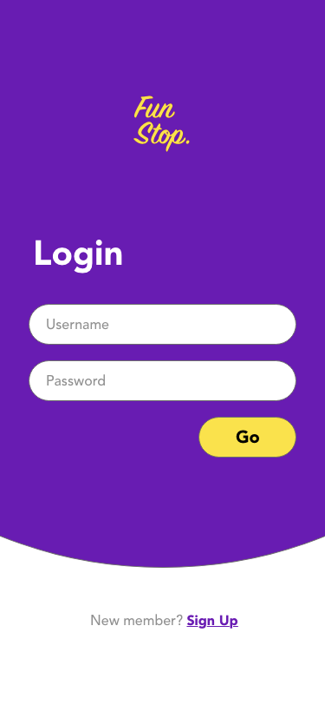
User Interface Design
Minimal Design
Simple colors, themes, layout
Efficiency
Ease of Use
User experience
Frontend work
User Expectations
Careful Transitions
Efficiency
Distraction
User Experience

Slide 18
What About Google/Apple Maps?
Google/Apple Maps
Main purpose is to provide efficient navigation (aka Point A - Point B)
Routes account for traffic, detours, construction, tolls, etc…
Both let users add stops, but even Google Maps’ “For You” is not known to provide consistently satisfactory suggestions
FunStop
Specializes in providing accurate, personalized recommendations to the user
User can manage likes/dislikes/preferences to maximize consistent results
Convenient navigation where user creates their own routes
Routes can be downloaded to the device’s local drive in case internet connection is weak

Slide 19
Future of FunStop
Launch on iOS App Store
Regular software patches/firmware updates
React to user feedback
We can enable social media sharing where people can share their trips with friends/family
We may partner with a rideshare company for road trips that have planned stops done by personal drivers

Slide 20
Conclusion
Aspired to create an interactive travel app for navigation and customizable stop
FunStop!
Unique features and accurate, versatile navigation
During early stages, we considered Layered but decided MVC was optimal
Greater advantages, better model for data interaction
Designing the model and UI thereafter was productive and efficient

Slide 21
REFERENCES (IEEE):
[1]. M. File, Boy in back seat of car. 2013.
[2]. W. James, Car Window. 2017.
[3]. M. File, Boy in back seat of car. 2013.
[4]. S. Hampton, Texas Exit Sign. 2018.
[5]. D. Patch, Mileage Sign. 2017.
[6]. M. Johnson, Cadillac Ranch. 2015.
[7]. S. Scott, Road Stop. 2020.
[8]. L. Balbierz, American RoadTrip Map. 2013
[9]. C. Schneider, Randal Olson Map. 2015
[10]. J. Allen, Friends with Map. 2018
[11]. L. Blair, Plan Traveling Cliparts. 2017

Slide 22


